Slide 1


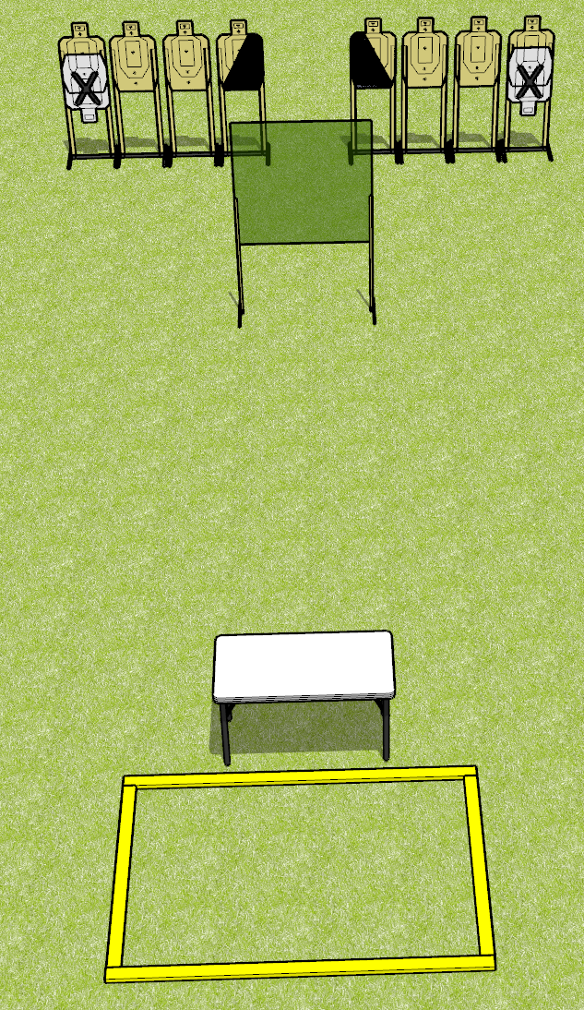
 | Dothan Gun Club – USPSA Match Off the Table Course Designer : Drew Coleman
Round Count 16 rounds 8 USPSA
Equipment List 2 wall feet 2 medium, 2 8’ fault lines 1 left + 1 right diag, 8 targets (6 + 2 NS)

Slide 2
Off the Table
Written Stage Briefing
Off the Table is a 16 round, 80 point, Comstock course of fire. There are 8 USPSA targets. The best 2 hits will score.
Start position is heels touching rear fault lines, wrists below belt. Firearm is on table, trigger guard on mark, unloaded. All magazines to be used on stage start on the table.
On the audible start signal, engage targets as they become available from within the shooting area.

